Slide 1
Narcovet
Giulia Bleichenbacher
Sarah Deckarm
Leonie Isele
Firat Turan
The solution for automated management of narcotics in veterinary practice

Slide 2
The problem we takle:
Narcotics require strict documentation – often paperwork, no digitalization
Many individuals involved (veterinarian, team responsible for narcotics, team responsible for supply chain) – no clear structures, some responsibilities not defined/assigned
Lots of time and money wasted

Slide 3
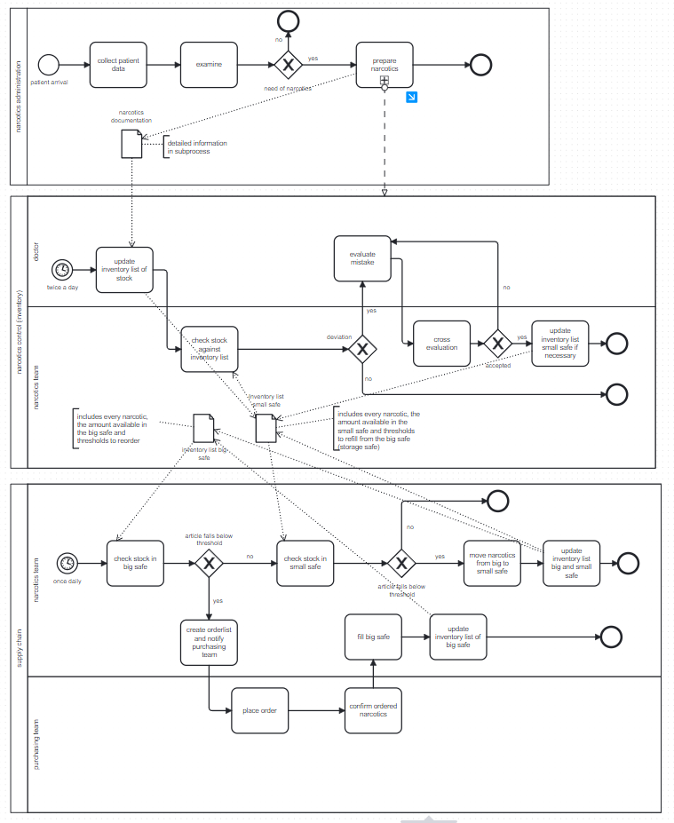
AS IS Process

Slide 4
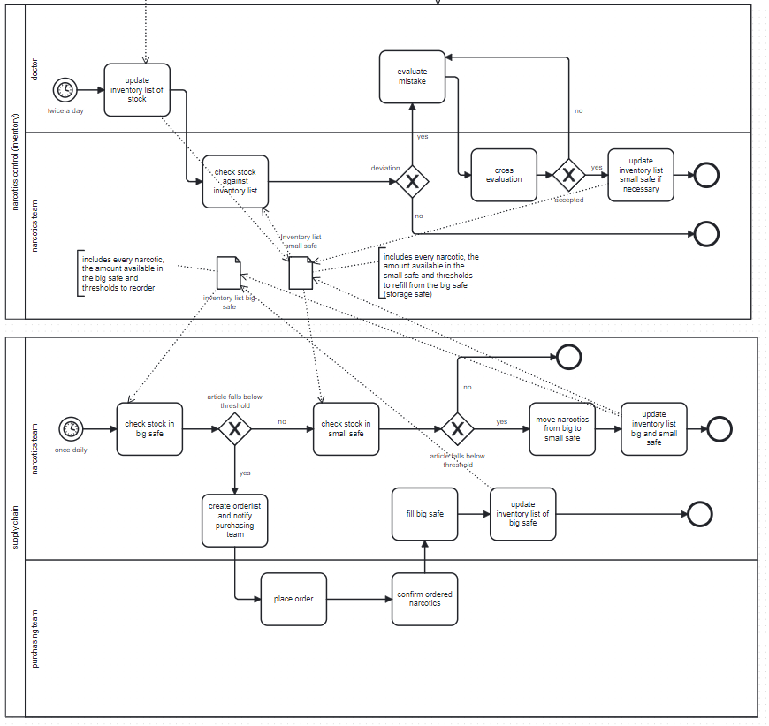
AS IS Process – main process of interest

Slide 5
TO BE Process

Slide 6
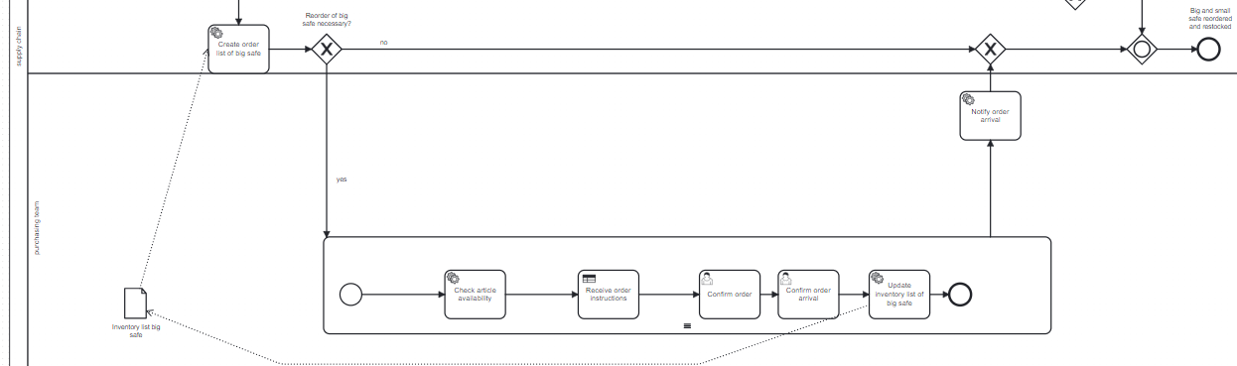
TO BE Process

Slide 7
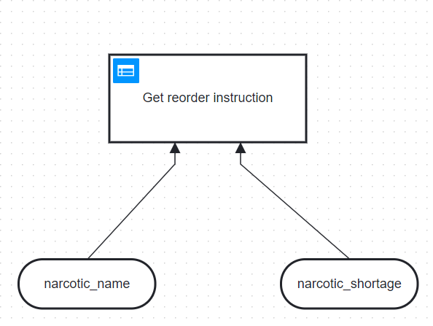
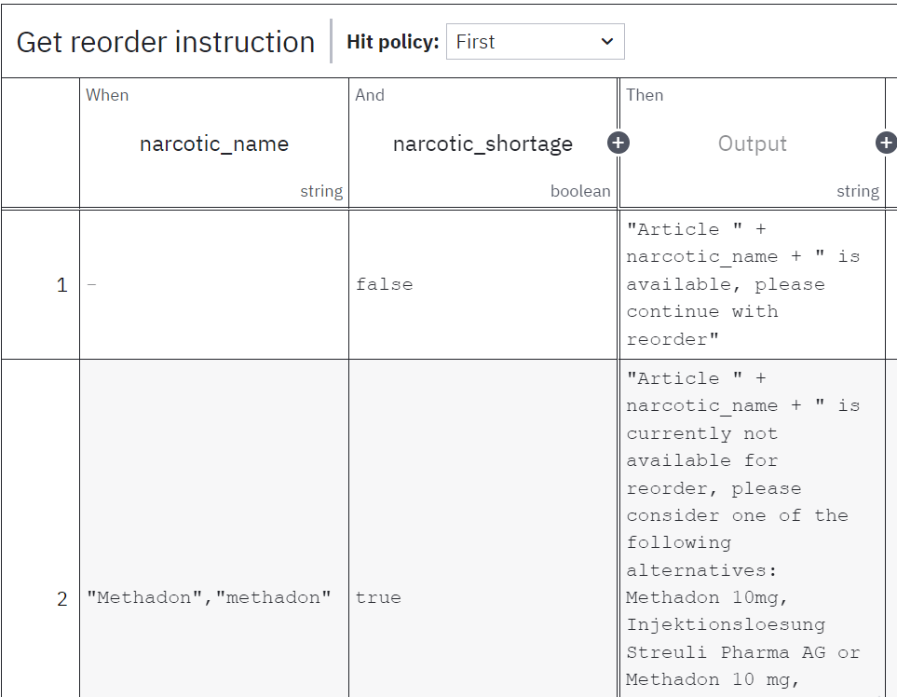
TO BE Process

Slide 8
The solution we provide
talking about technical details
Automation:
inventory is checked as time event automatically
Returns if threshold is under orover limit
placeholder
Unification:
Decision support:
use of Camunda, Python,
Multiple service tasks, Decision modeling

Slide 9
How to implement Narcovet

Slide 10
Demonstration
Video einfügen

Slide 11
Benefits
Reduction of hours spent on narcotics management reduced by estimated:
180h per year without Narcovets
67h per year with Narcovets
Reduction on money spent on narcotics management reduced by estimated:
10.000CHF per year without Narcovets
5.000CHF per year with Narcovets
On top:
Centralized documentation
Less risk for human errors or human intervention to cheat wrong numbers

Slide 12
Conclusion
Problems
Solutions
Exlusively paper based
No automation
Unclear responsibilities
Time consuming
No decision support for alternative medications
Inventory list: digitalised
Automated e-mail generation for updated inventory lists
For order arrival too?
Decision logic implemented to enable quick access to alternative medications

